Slide 1
Create a key to login to ec2

Slide 2
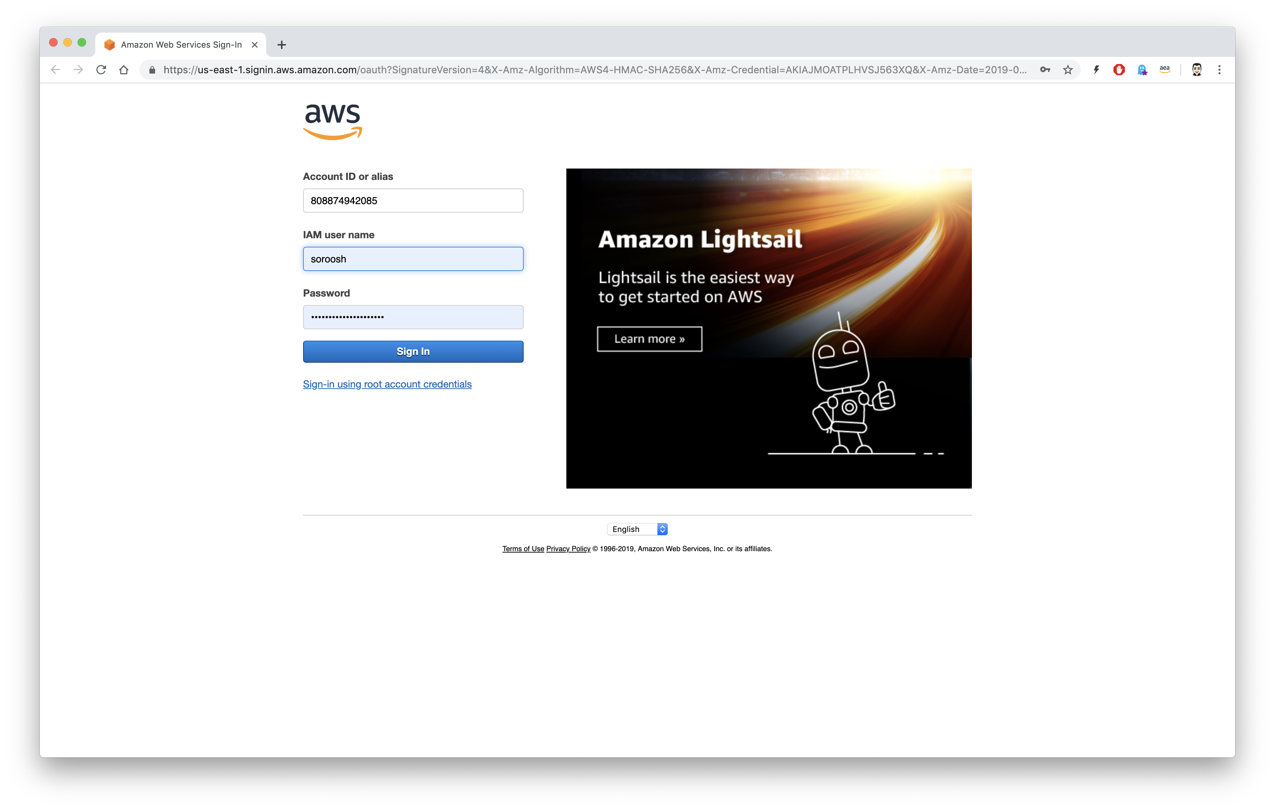

Login in to the console.
Login using your Account ID, new user user name and Password.

Slide 3
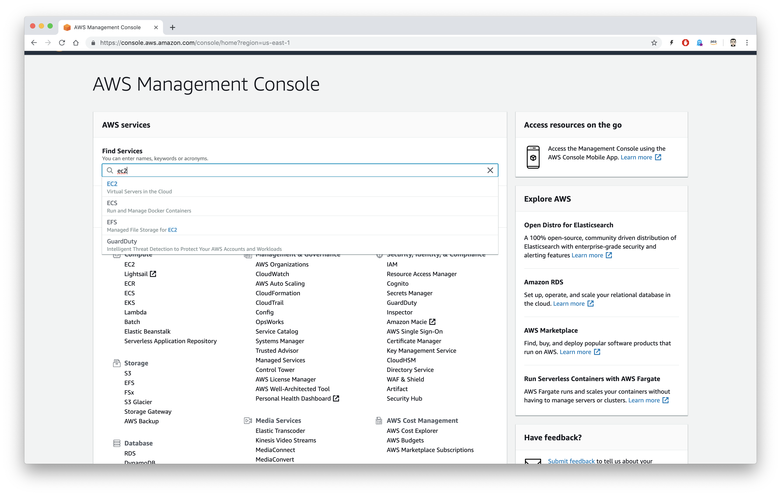

AWS Management Console
Find ec2 using Find Services

Slide 4
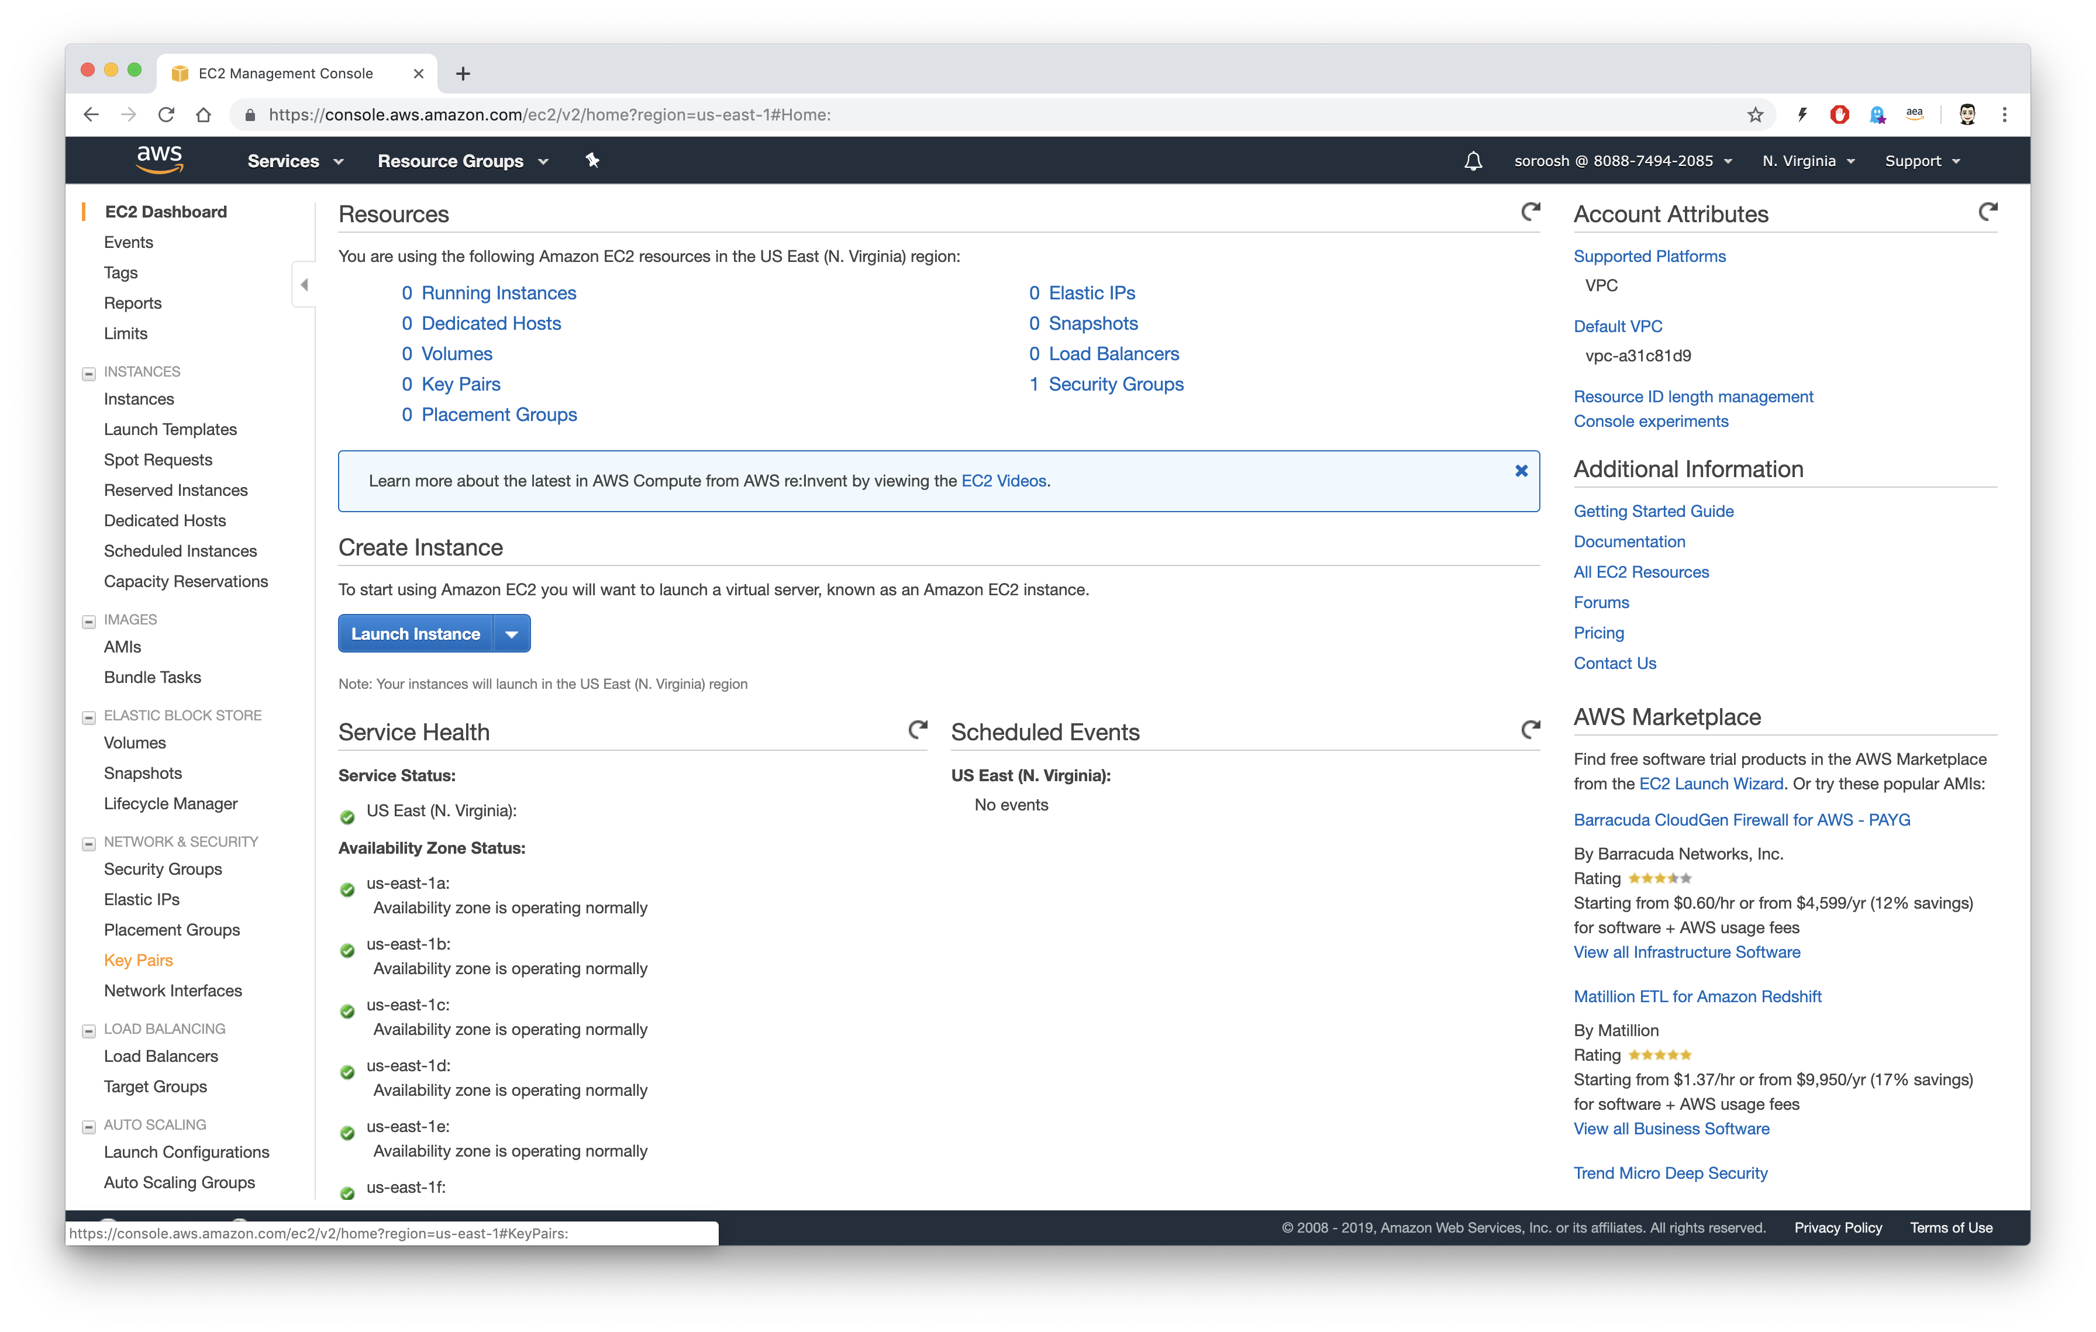

Key Pair
Click on Key Pairs

Slide 5
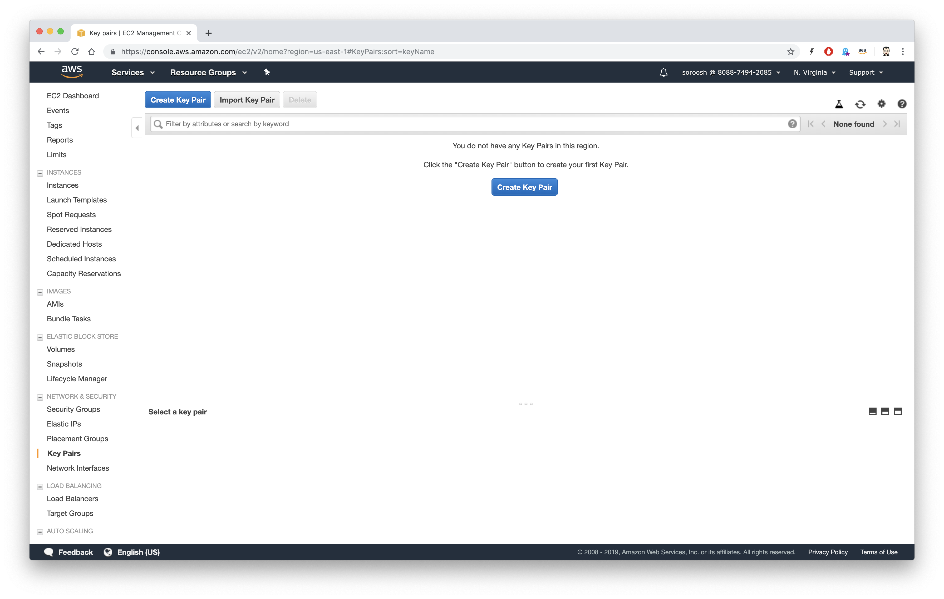

Create Key Pair
Click on Create Key Pair

Slide 6
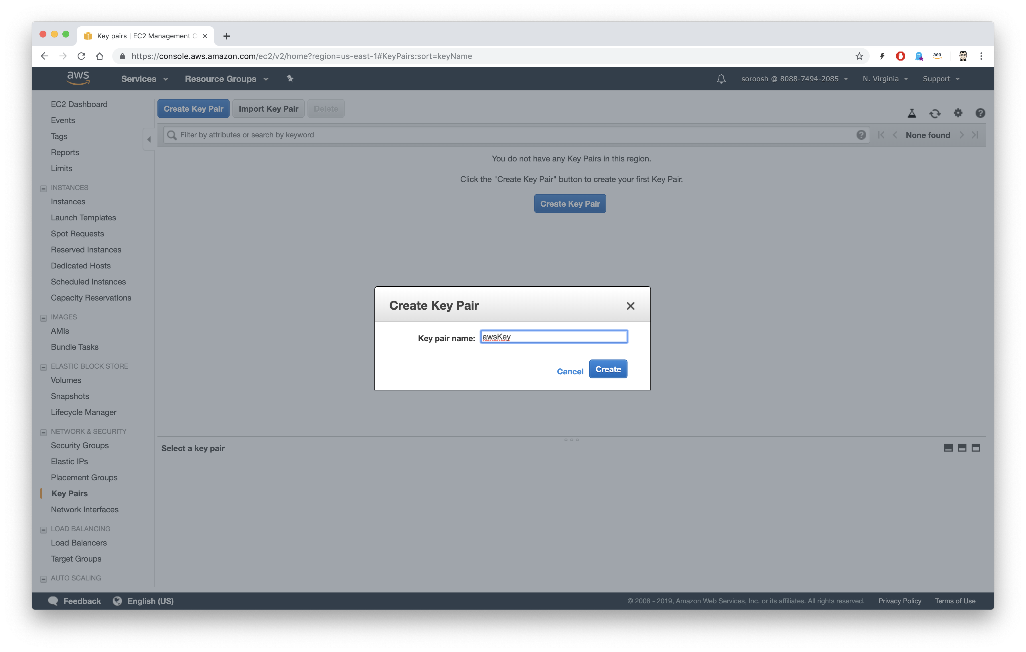

Create Key Pair
Enter a new for your key and click on Create

Slide 7
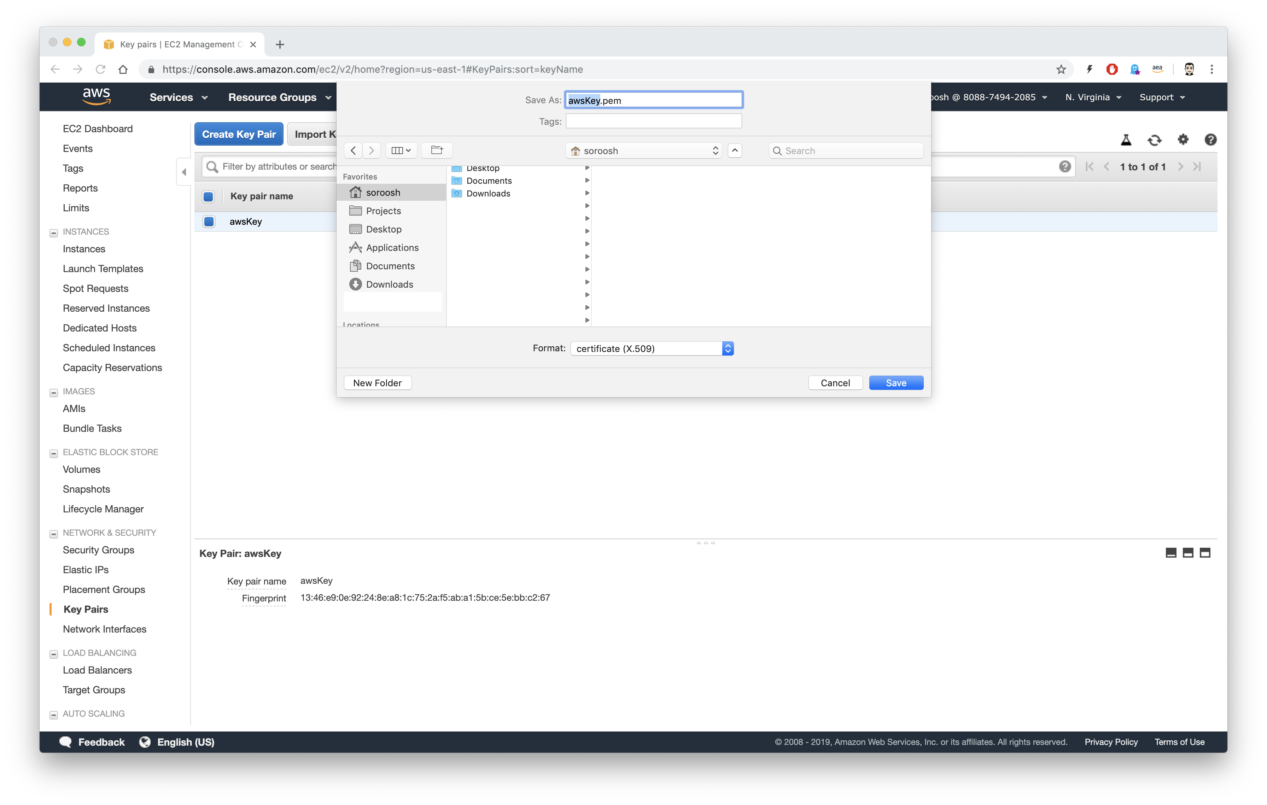

Save AWS key
Save your key anywhere you want (I am saving in my home directory)

Slide 8
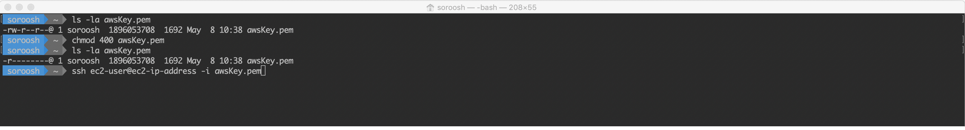
Mac Users
Open your terminal
cd to the directory you save your key
change the access permission using chmod 400 <name of your key>
Now your can use this key to ssh to ec2 instances

Slide 9
Windows users
Follow the following steps:
https://www2.linuxacademy.com/howtoguides/17385-use-putty-to-access-ec2-linux-instances-via-ssh-from-windows/

